Slide 1

destroyed buildings
February 24, 2022

Slide 2
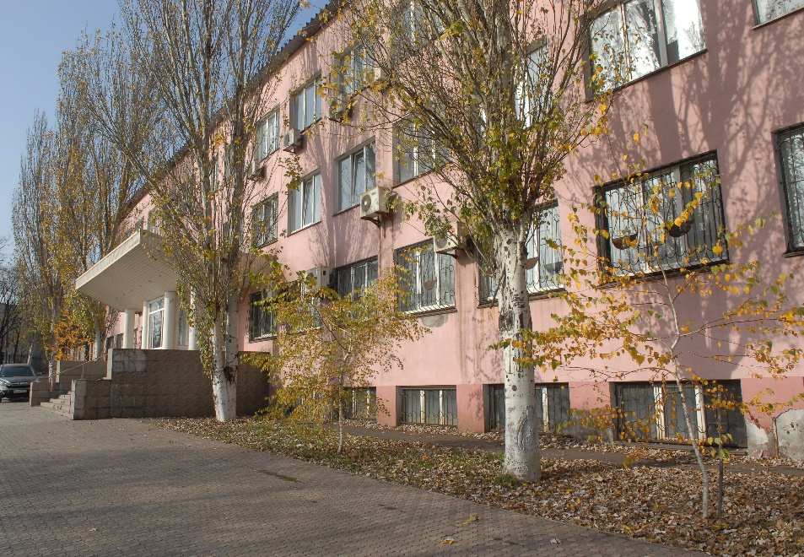
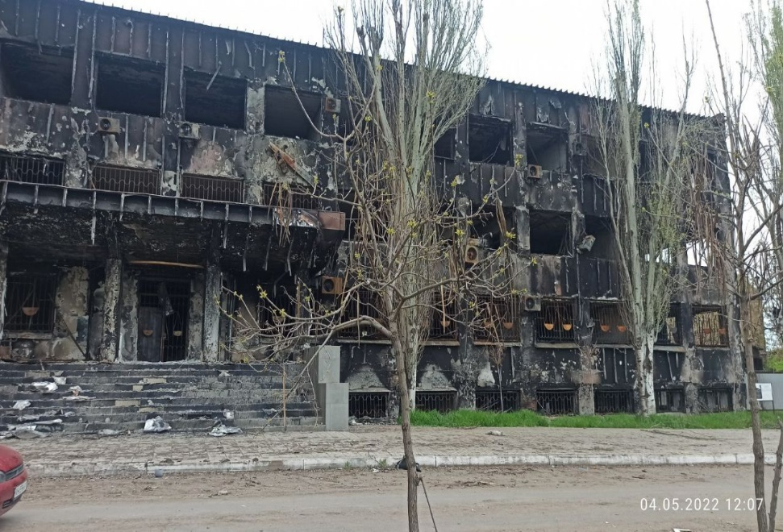
12 court premises are completely destroyed
Donetsk Court of Appeal (Mariupol)
Notes:
2

Slide 3
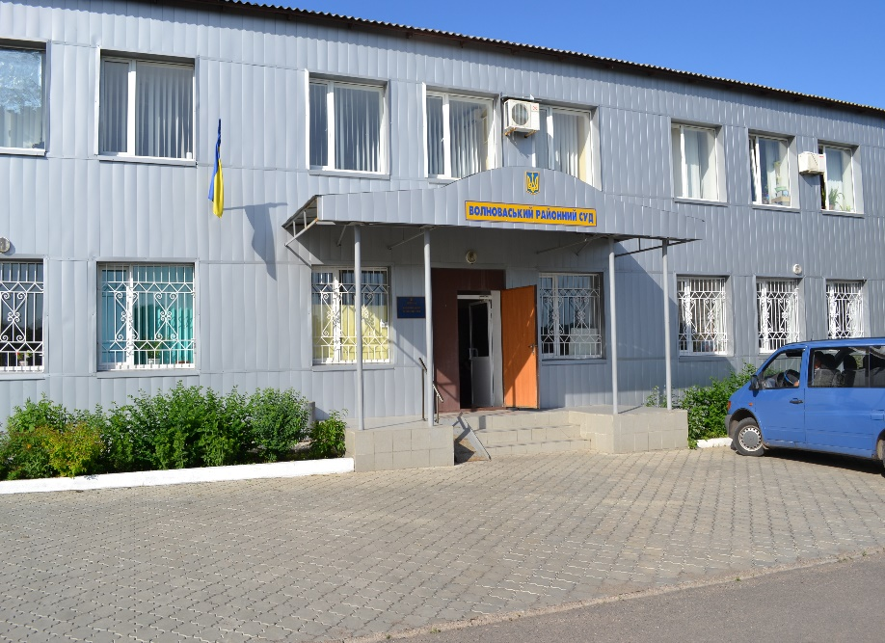
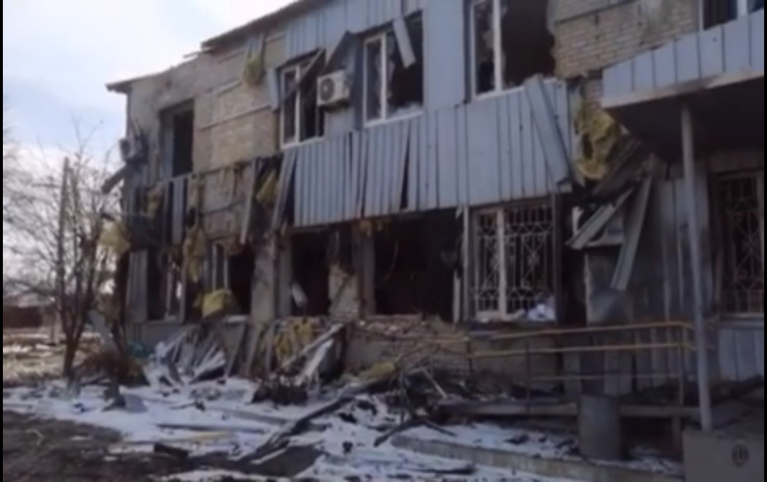
Volnovasky district court of Donetsk region
Notes:
3

Slide 4
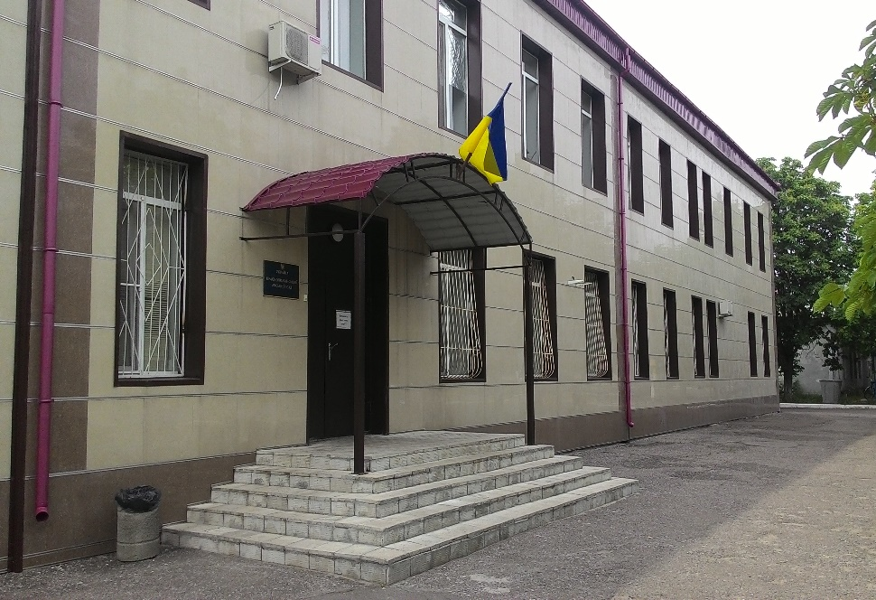
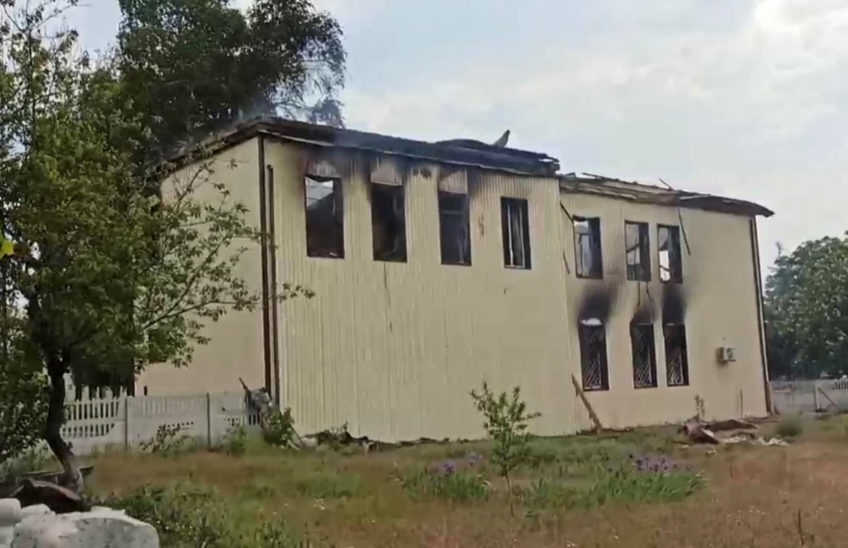
Krasnolymansk city court of Donetsk region
Notes:
4

Slide 5
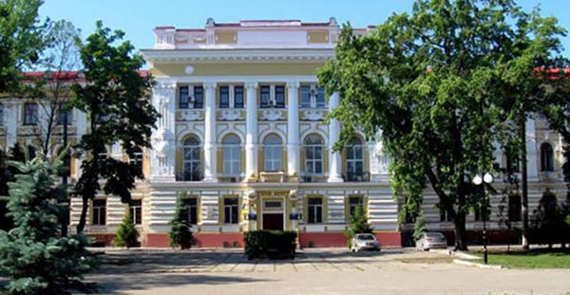
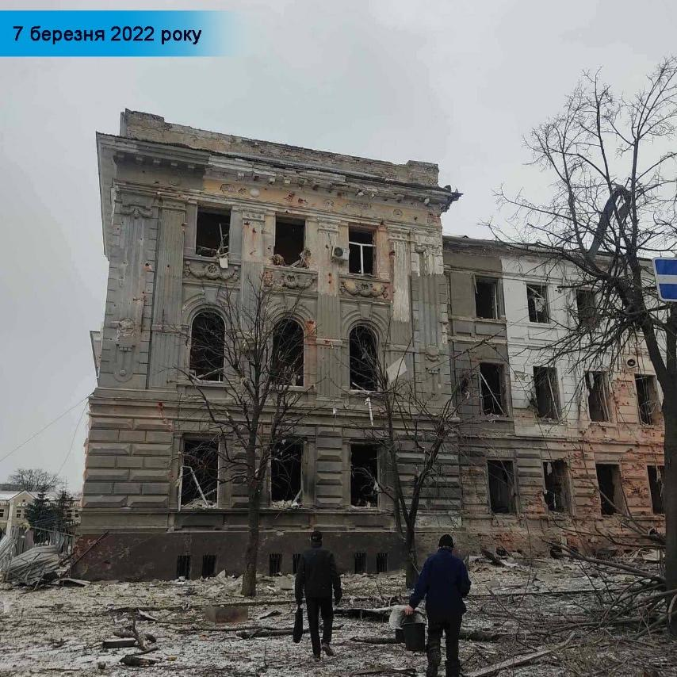
Kharkiv Court of Appeal
Notes:
5

Slide 6
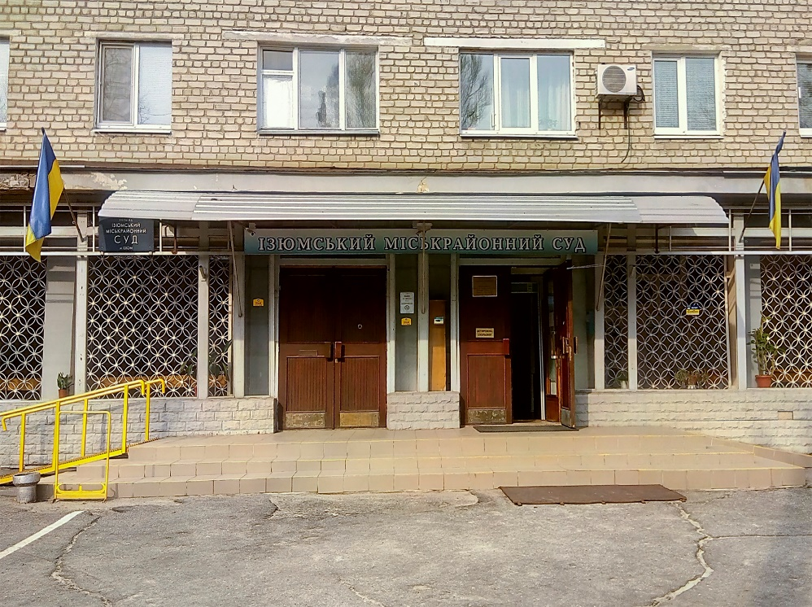
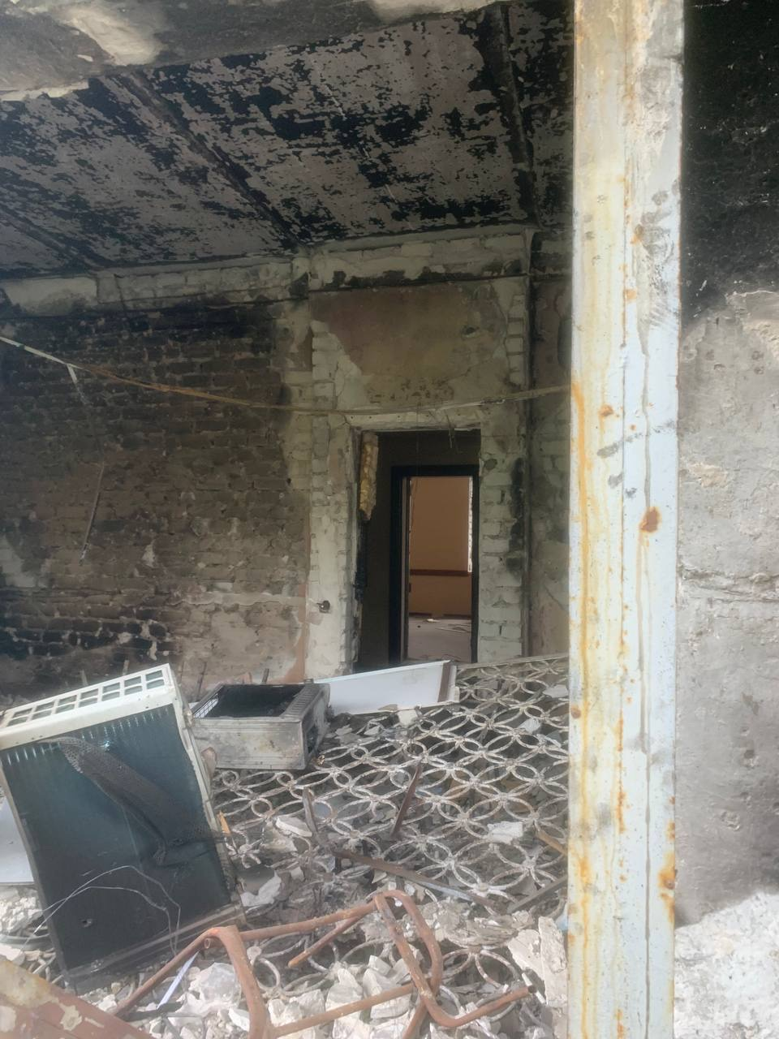
Izyum City District Court Kharkiv region
Notes:
6

Slide 7
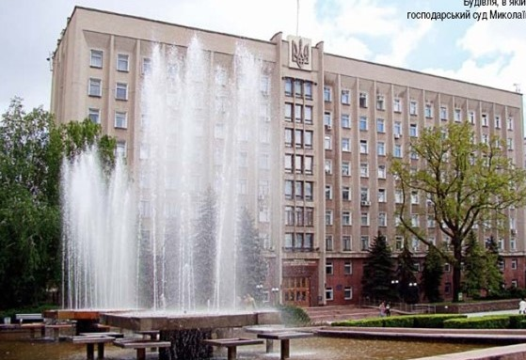
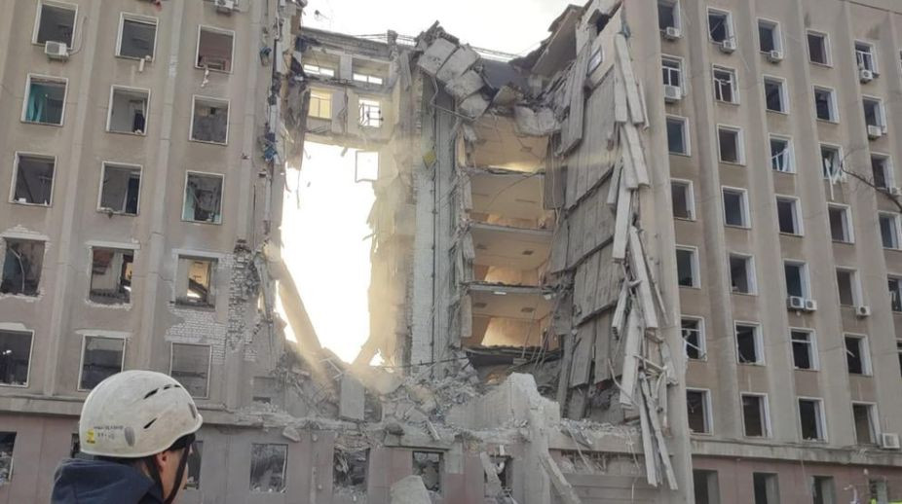
Commercial Court of the Mykolaiv Region
Notes:
7

Slide 8
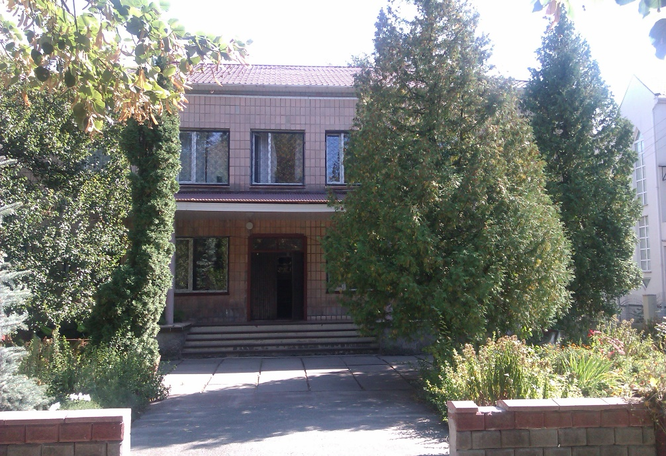
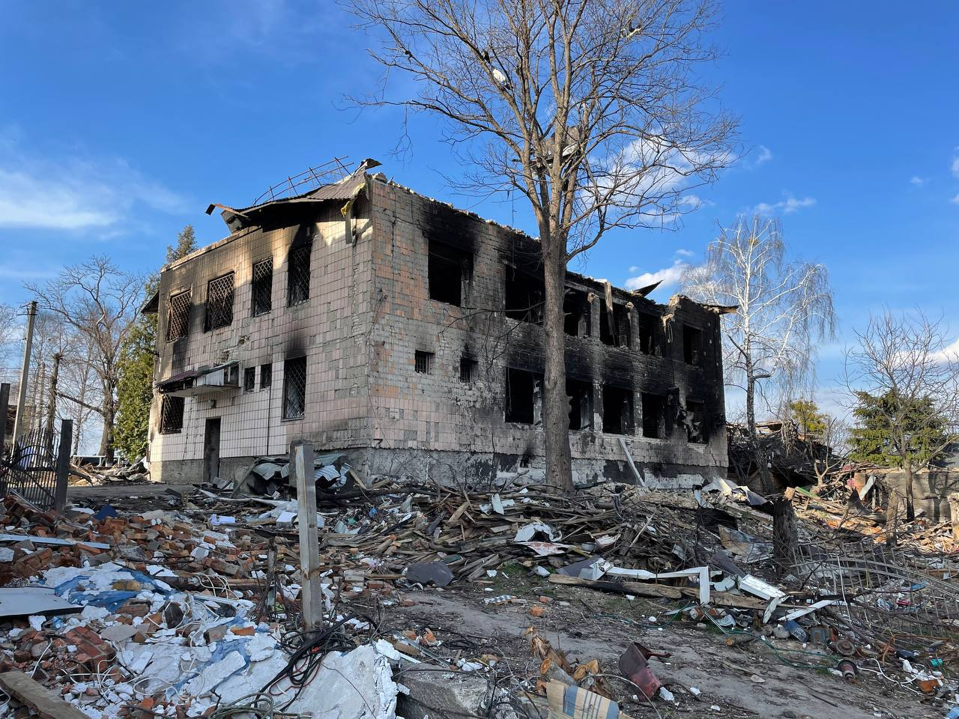
Borodyansky district court of Kyiv region
Notes:
8

Slide 9
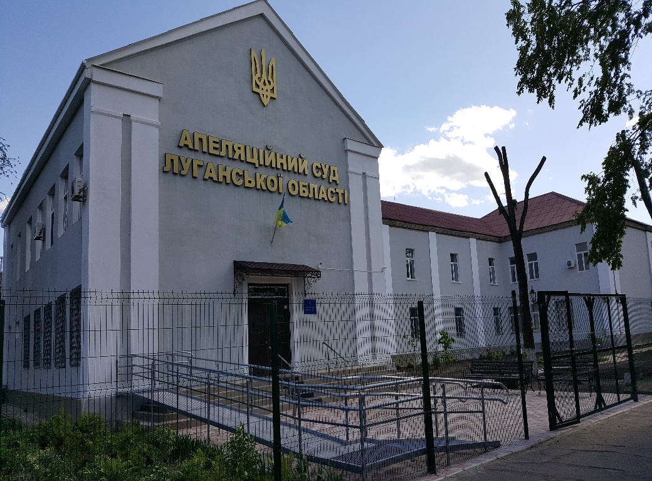
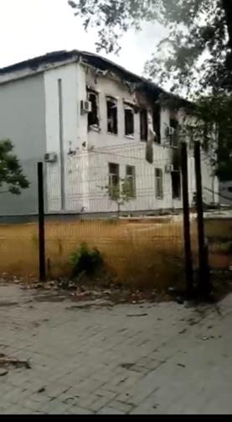
Luhansk Court of Appeal
Notes:
9

Slide 10
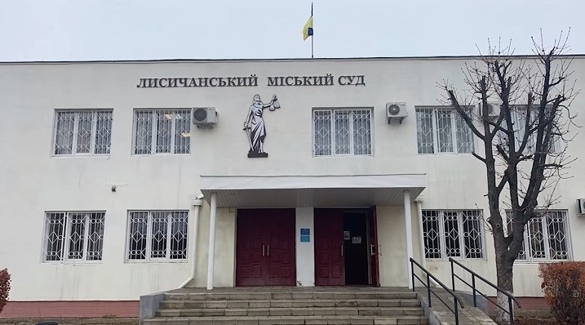
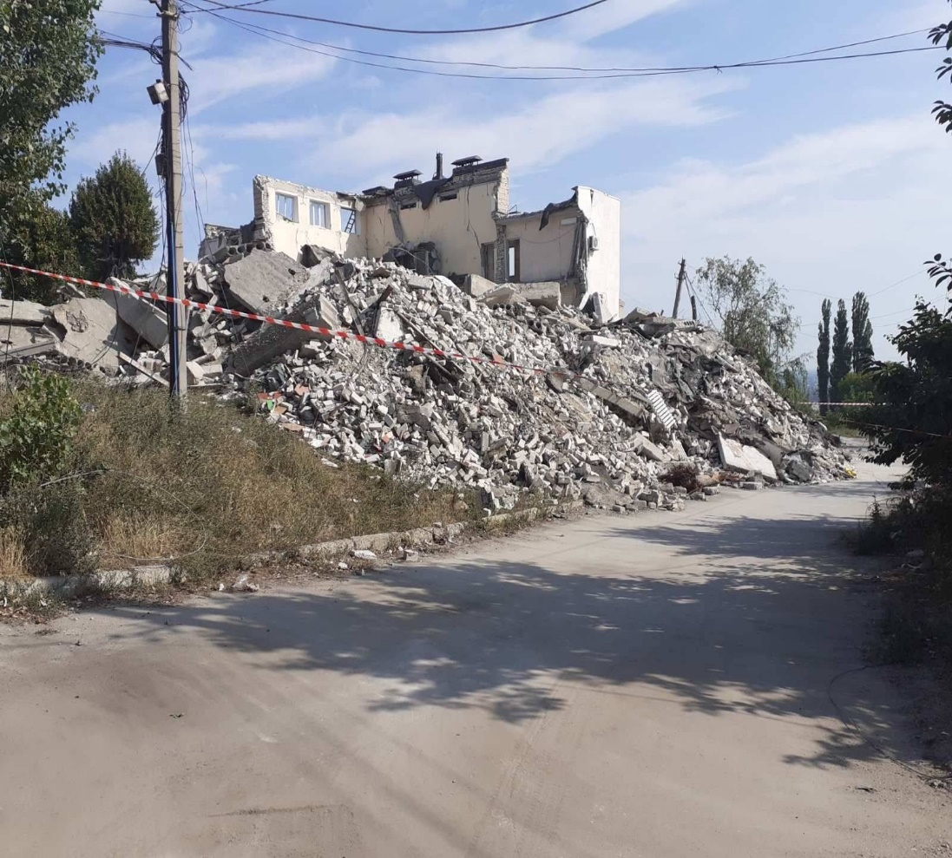
Lysichan city court of Luhansk region
Notes:
10

Slide 11
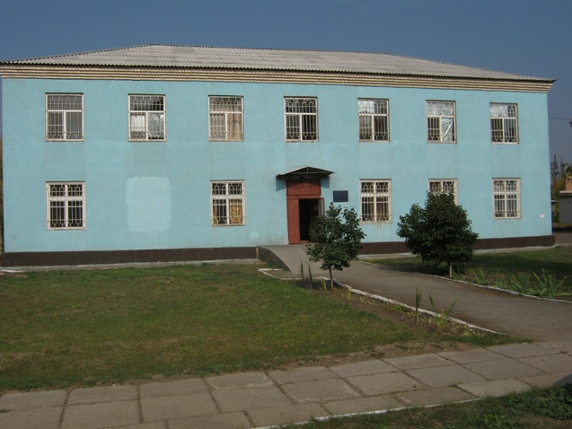
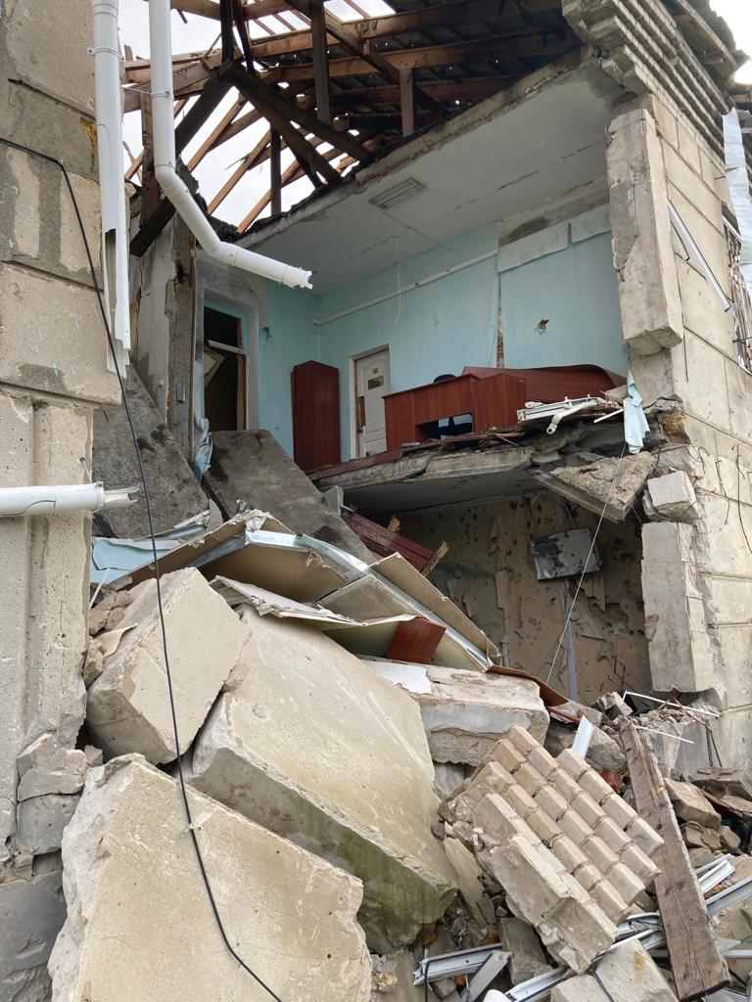
Vysokopil District Court Kherson
regionarea 470.2 square meters m
Notes:
11

Slide 12
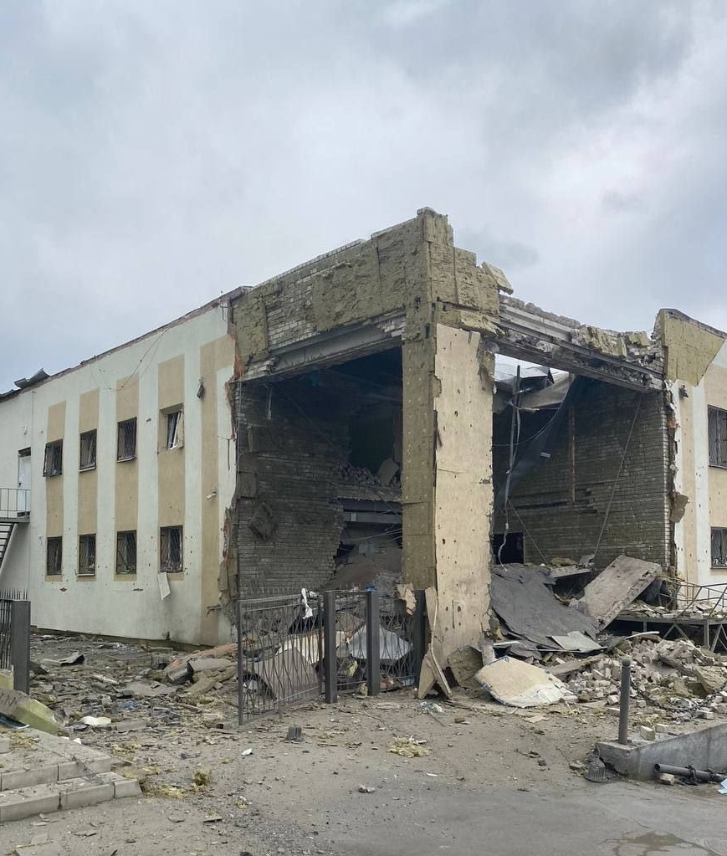
Kupyanskyi City District Court of Kharkiv Region
Notes:
12

Slide 13
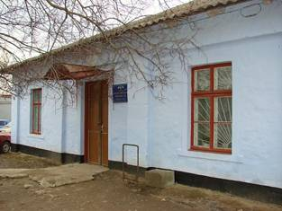
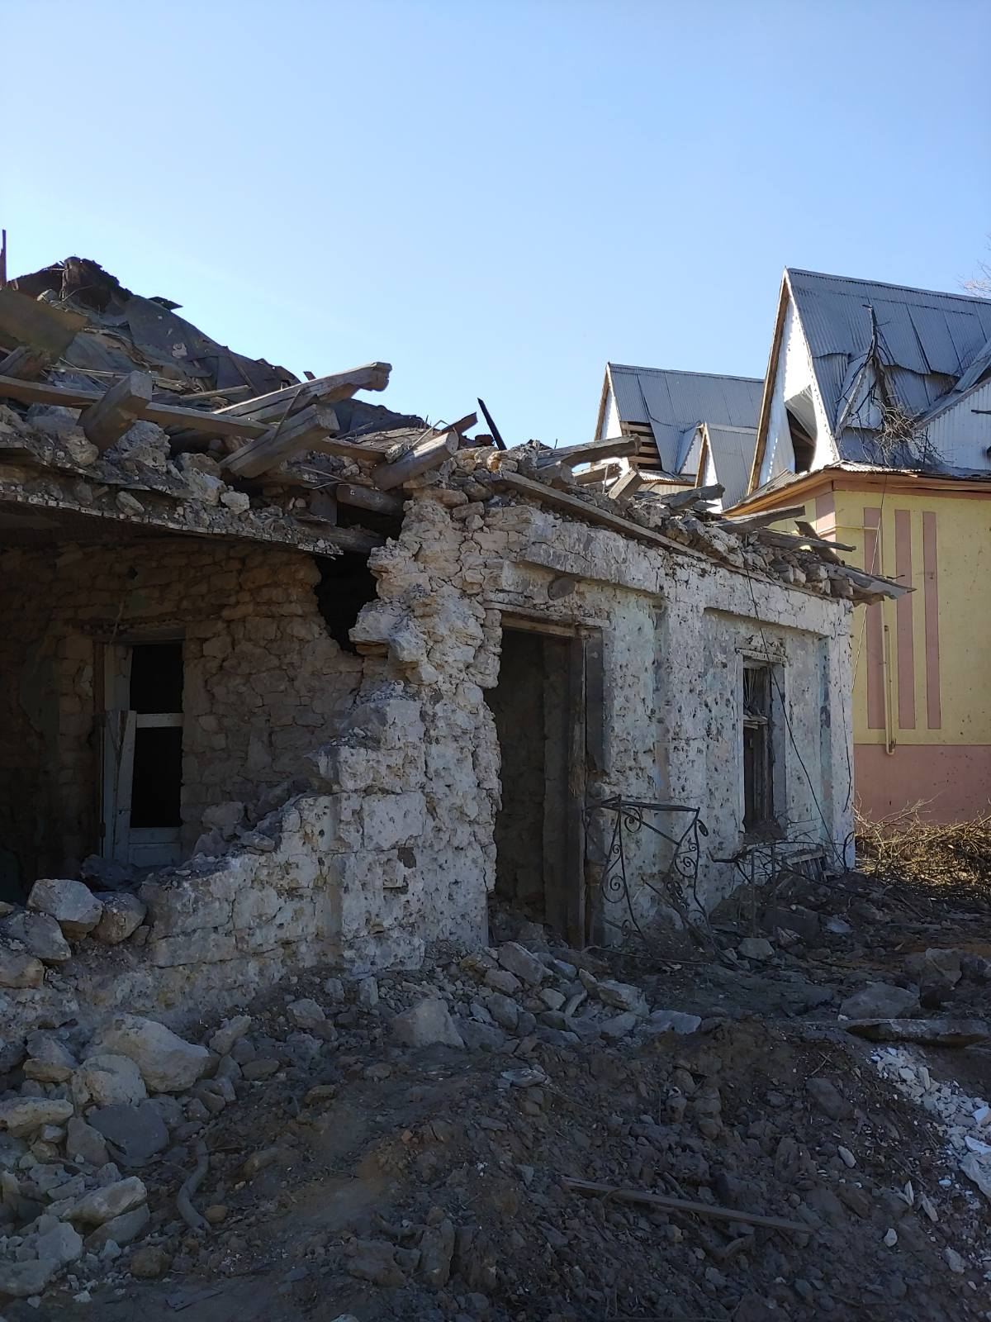
Berezneguvatsky district court of Mykolaiv region
Notes:
13

Slide 14
As of November 21, 2022, the total area of destroyed court premises is 22,183.9 square meters. meters The total book value of the destroyed property is 199,985.8 thousand hryvnias

